Slide 1
2. pH Indicators
GE002

Slide 2
You need to be able to….
Interpret the pH scale.
Select and use pH indicators.

Slide 3
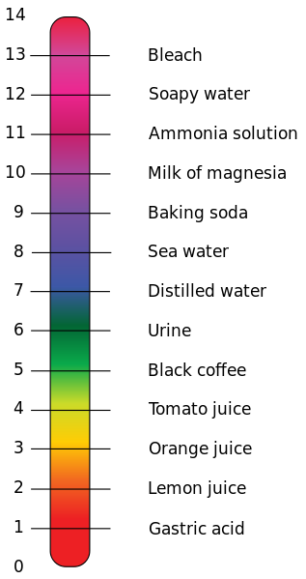
pH scale
The concentration of hydrogen ions in a solution is measured using the pH scale.
Water, which is neutral, has equal numbers of hydrogen and hydroxide ions (pH of 7)

Slide 4
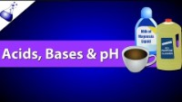

Slide 5
Using Red Cabbage as a pH indicator

Slide 6
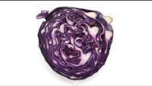

Slide 7
Measuring pH
Universal indicators change the colour of the solution to show where a solution lies on the pH scale.
An acidic solution will turn yellow to red, a neutral solution will be green and a basic solution will turn blue to purple.

Slide 8
Acid – base indicators
Are products that change colour depending on the pH of the solution that they’re put in.
They help measure the pH of a solution.
E.g. Litmus paper, universal indicator and bromothymol blue.
Universal indicator is particularly useful because it gives an indication of pH along the whole pH scale.

Slide 9
Page 138 in SW9

Slide 10


Slide 11
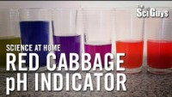

Slide 12
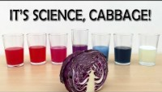

Slide 14
Are you now able to….
Interpret the pH scale?
Select and use pH indicators?

